Slide 1

Project
ON
Cricket Analysis Of The
Indian Premier League (IPL)
PRESENTED BY:
S.ANUHYA
R.MANASA RAGAVRAJU

Slide 2

CRICKET ANALYSIS
OF THE INDIAN PREMIER LEAGUE (IPL)

Slide 3
ABSTRACT:
Cricket is one the most watched sport now-a-days. Winning in cricket depends on various factors like home ground advantage, performances in the past matches experience of the players, performance at the specific venue, performance against the specific team and the current form of the team and the player.
In the recent past , a lot of research has been done which measures the player’s performance and predicts the winning percentage. This article briefs about the factors that cricket game depends on and discusses various researches which predicted the winning of a team with an advent of statistical modeling in sports.
Cricket is one of the most popular team games in the world. With this article, we embark on predicting the outcome of Indian premier league (IPL) cricket match using a supervised learning approach from a team composition perspective. Our work suggests that the relative team strength between the competing teams forms a distinctive feature for predicting the winner.
Modeling the team strength boils down to modeling individual players batting and bowling performances, forming the basis of our approach .
We use statistics and recent performance of a player to model him. Player independent factors have also been considered in order to predict the outcome of a match .

Slide 4
OVERVIEW OF DATA ANALYSIS:
.
.
Data Exploration
.
Deployment
Business Understanding
4.Data Preparation
Data Modeling
6.Data Evaluation

Slide 5
INTRODUCTION:
Cricket, or the gentleman’s game is a very old, widespread and uncomplicated pastime game. In the late 16th century, the sport of cricket has originated in the southeast England. It became the country’s national sport in the 18th century and has developed globally in the 19th and 20th The International Cricket Council (ICC) Cricket World Cup, a One-Day International (ODI) cricket, is the flagship event of the international cricket calendar and takes place every four years with matches contested in a 50-over format. It is the biggest cricketing tournament and one of the world’s most viewed sporting events. While, the Indian Premier League (IPL), a one-day cricket in India with matches contested in a 20-over format is the most watched cricket league in the world. It is a tournament centuries and yet the most popular game of the today’s world. It is a game of uncertainty. One cannot predict outcome of the game up to the last moment of the game though the possible results are known to all, therefore, an appropriate probability model can be applied to predict the result.

Slide 6
MODULES USED :
PANDAS
CSV
SEABORN
NUMPY
MATPLOTLIB
OS

Slide 7
SYSTEM REQUIREMENTS:
Anaconda software to be installed.
Microsoft windows 10/8/7/vista /2003/XP.
For Anaconda –Minimum 3 GB disk space to download and install.
4 GB RAM recommended.
All the required modules must be installed using PIP.

Slide 8
DATA SETS :
Required Data sets are obtained from the different websites such as Kaggle and all are compiled into one, of csv file format consisting of 2008-2019 IPL data sets.
These data sets consist of various factors such as different seasons, toss decision, winners, win by runs, win by wickets, man of the match, venue and umpires.

Slide 9
DATA VISUALIZATION:
Data visualization is the discipline of trying to understand data by placing it in a visual context so that patterns, trends and correlations that might not otherwise be detected can be exposed.
Data Analysis of IPL matches are shown by plotting various graphs, bars and figures.
Some of the major charts obtained from data analysis are shown below:

Slide 10
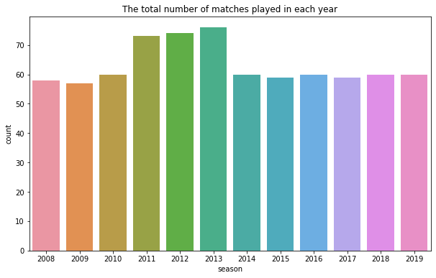
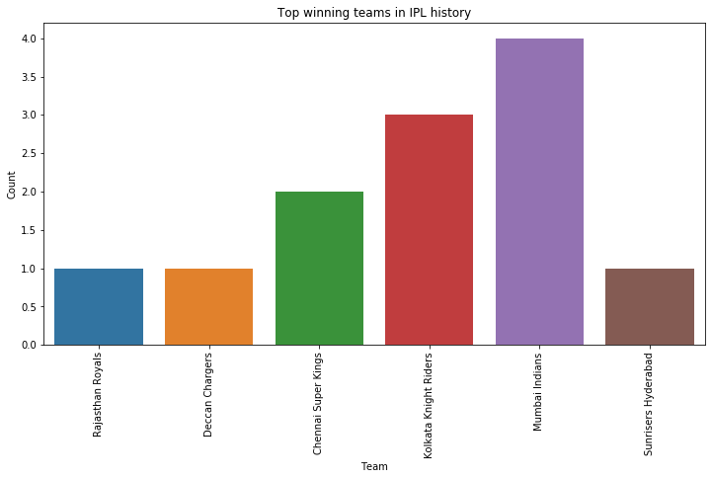
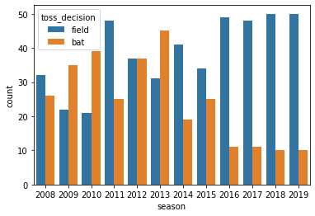
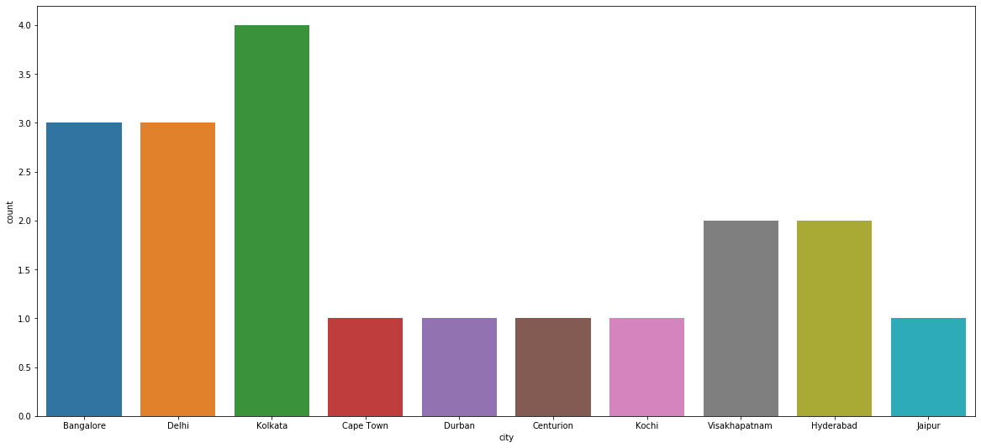
TOTAL NO.OF MATCHES PLAYED IN EACH YEAR:
TOP WINNING TEAMS IN IPL HISTORY:
KKR
MI
CSK
RRR
SRH
DC
TOSS DECISION ACROSS THE SEASONS :
CITIES EFFECTED BY WEATHER:

Slide 11
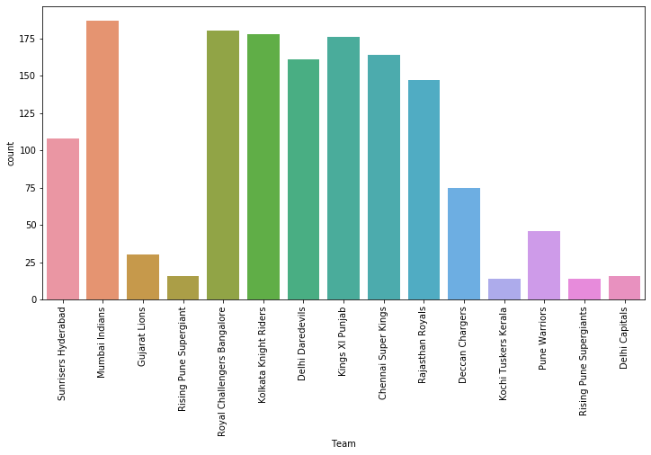
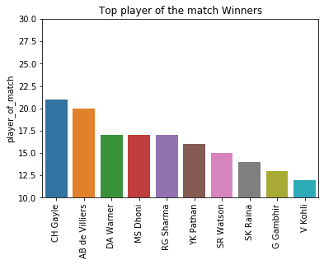
TOP PLAYERS OF THE MATCH :
MOST PLAYED TEAMS:

Slide 12
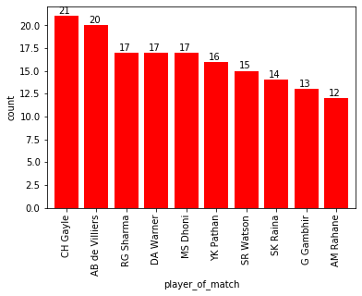
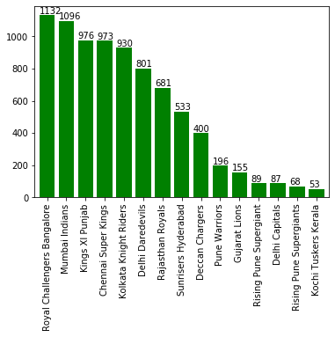
PLAYER OF THE MATCH :
TEAM’S WITH MAXIMUM SIX’S:

Slide 13
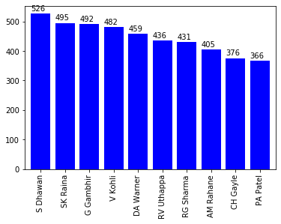
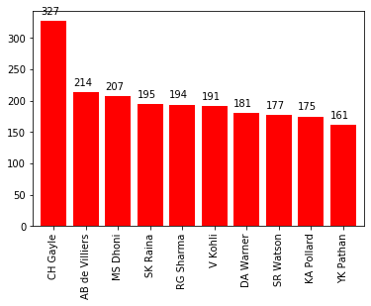
PLAYER’S WHO SCORED MAXIMUM FOUR’S :
PLAYER’S WHO SCORED MAXIMUM SIX’S:

Slide 14
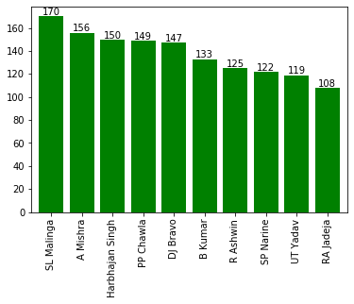
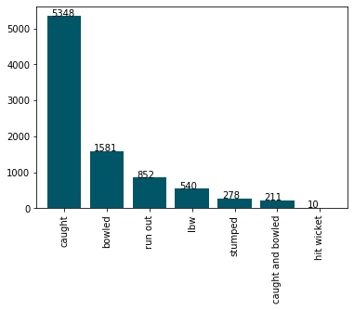
TOP BOWLER’S:
WICKET FALL’S:

Slide 15
CONCLUSION:
This data is beneficial for the coach as he can rank the Cricket Predictor and Analytics players on their priority from the previous data, it is beneficial to the owner to get the details of the IPL match played and the users who predict the winning percentage of the team and get the statistics of the player.

Slide 16
REFERENCES:
https://en.wikipedia.org/wiki/Indian_Premier_League
https://www.iplt20.com
https://towardsdatascience.com/analysing-ipl-data-to-begin-data-analytics-with-python-5d2f610126a
https://techtrunk.in/ipl-data-analysis/

Slide 18


